Slide 2
1 Corinthians 11:17-34

Slide 3
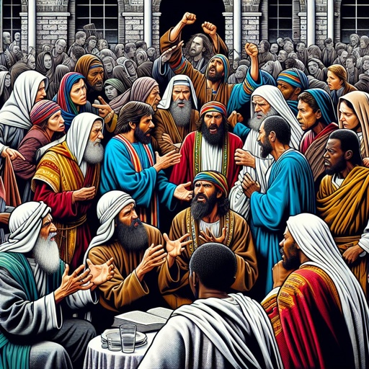
Not Approved By Paul
17 “Now in giving these instructions I do not praise you, since you come together not for the better but for the worse.”

Slide 4

V.18 “ Come Together As A Church”
Action was Congregational as opposed to Individual

Slide 5
V.20 “When you Come Together in one place”
The BODY – Congregational Action
Thought they were coming together to eat the Lord’s Supper!

Slide 6
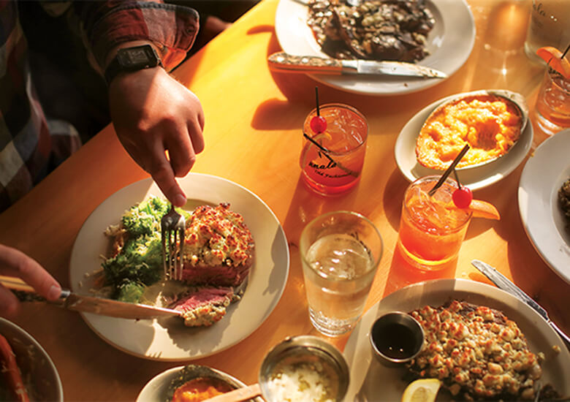
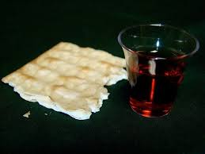
V.21 “in eating, each one takes his own supper..”
They were taking “their own supper” first
Difference between the “Lord’s Supper” and our “Own Supper!”

Slide 7


V.21 “one is hungry, and one is drunk”
Hungry- “a craving or urgent need for food”
Drunk- “to be drunk with wine…being intoxicated”

Slide 8
V.22 “What! Do you not have houses to eat & drink in?”
WHAT DID PAUL SAY THEY COULD DO AT HOME?
IF he said they could GET DRUNK at home, why would he CONDEMN such in 1 Corinthians 6:10?
Eat - ESTHIO
Drink – PINO
“to use food and drink to satisfy one’s hunger and thirst”
Hunger to be satisfied NOT as a “coming together as the church” but a HOME function
“HOUSES” in apposition to “WHEN YOU COME TOGETHER AS A CHURCH”
“a house, dwelling, an abode”
IF there is NO DIFFERENCE in their “COMING TOGETHER” and their “HOMES” why did Paul say this?

Slide 9
V.22 “or do you despise the church of god and shame those who have nothing?”
“What! Do You Not Have Houses To Eat And Drink In?”
Disrespectful conduct, whether it be toward GOD or our brethren is ALWAYS WRONG!
DRUNKENNESS is ALWAYS WRONG!
Paul did NOT SAY: “Get drunk at home, or Disrespect or SHAME those who have less AT HOME!
He DID SAY: “satisfy your HUNGER AT HOME!”
They DESPISED THE CHURCH OF GOD and SHAMED THOSE WHO HAD NOTHING!
He DID NOT say: “bring enough for everyone so none will be shamed!”

Slide 10
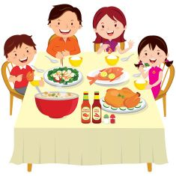
V.34 “but if anyone is hungry, let him eat at home”
The Physical Need For Food
“LET HIM EAT…”
The LORD’S SUPPER?
NO!
“His OWN SUPPER?” V.21
YES!
For what purpose will he EAT?
To satisfy HUNGER!
Where will he eat it?
AT HOME!”
“Then, I cannot eat at YOUR HOUSE or at a RESTAURANT!”

Slide 11
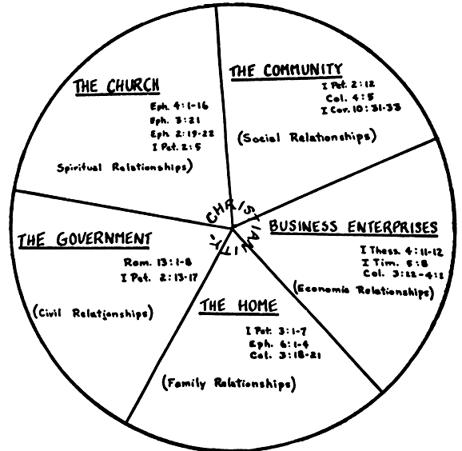
Different relationships we have:
Spiritual
(Romans 14:17)
Social
Civil
Economic
FAMILY

Slide 12
V.34 “lest you come together [as the church v.18] for judgement”
“What about Acts 20:11?”
Acts 20:7 “disciples came together to break bread”
EATEN – “take food… nourishment”
BROKEN BREAD- “used in NT of the breaking of break or communion”
Paul preaches till midnight
Man falls from third floor
Raises him from the dead
Went back up stairs
Observed the Lord’s Supper
Took Nourishment
Then he left
“CONDEMNATION!”
When the church functions as a BODY for the purpose of satisfying HUNGER and THIRST,
as a SOCIAL gathering, they are DESPISING the CHURCH OF GOD and bringing CONDEMNATION upon themselves!

Slide 13
V.34 “lest you come together [as the church v.18] for judgement”
Anyone who PRESUMES that the church PAID FOR THE PLACE IN TROAS must PROVE IT!
First century practice was to meet in PRIVATE HOMES
No Conflict with what Paul taught in Corinthians and what was practiced in Troas
Don’t let assertions be made, without demanding proof
Every assertion you let slide, will make your opponent’s argument more plausible to those they are trying to influence
Call him to GIVE THE PROOF or GIVE UP THE ASSERTION!
They were making provision for him as an APOSTLE and PREACHER who was going to depart the next day-
NOT simply having a SOCIAL gathering at the expense of the church of the Lord!

